Slide 1
Image Classification using Convolutional Neural Networks
Abhiram Tripuraneni

Slide 2
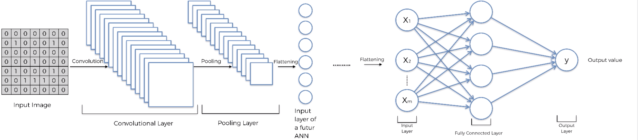
CNN System Architecture

Slide 3


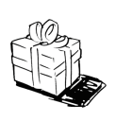

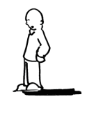
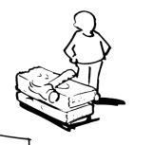
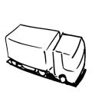


Business Model Canvas
Key Partners Institutional investors and funds Product manufactures Distribution partners Suppliers Retailers Acquisitions Publishers Stakeholders Media | Key Activities R&D Design Computer software/ Hardware Technology Image search Facial recognition Robotics Remote sensing Medicine Banking, Financing Forecasting |  | Value Propositions To revolutionize technology for both commercial and personal use Quality and excellence of software integrated with hardware Respect data privacy Advertising services Perpetual innovations Autonomous driving |  | Customer Relationships Distinctive marketing Unique products and trust Customer assistance Automation Learning resources | Customer Segments End users Mass market Multisided platforms Businesses Students and teachers
 |  |  |  |  | Channels Retail stores Online service Authorized resellers Events Advertisements
 | Key Resources Vision Best-in-class employees Ecosystem Inventories Data centres Inclusion and diversity approach Intellectual resources |  |  |  | Channels Retail stores Online service Authorized resellers Events Advertisements
Cost Structure R&D Advertising Design Software development |  | Cost of manufacturing Outsourcing Data Centres Marketing and sales Employees Customer service |  | Revenue Streams Sale of products Online services Licensing Advertising

Slide 4
Data Trust Framework
Data Policy | Propositions
Transparency: To inform the Individuals about the data that is recorded, the manner in which this data is recorded, the application of this data and the third parties that have access to it | Take consent before recording customers data Disclosing about data collection policies, business ethics, other public policy commitments Mention about what type of data we collect, why we collect it and how we use that data Inform users about the changes in the terms of service Create transparent policy which mentions about standardized factual information, details on specific products and signed agreement with the end users
Trust: To inform customers how their personal data is safeguarded in all means | Take consent from the users before sharing the data Ensure no personal information is sold to other business users or stolen Ensure information is only shared with the third party vendors so that they can provide right services to the end users Information should be protected with passwords and have an encryption in place to strongly protect user information
Control: The ability of individuals to effectively manage the extent to which their personal data is shared | The users must have full control to review the data that is being collected Having an option of opt-in/opt-out for the users to provide the consent of sharing their personal information with any third party vendors or not Can login to their personalized portals to see what data is being collected and can make changes as they wish They can view, download their data whenever they wish to
Value: Individuals’ understanding of the value created by the use of their data and the way in which they are compensated for it | To provide value added services to the customers Provide well crafted and personalized recommendations for each individual The more the data the customer agrees to share the better the services provided to the customer
Notes:
Change this slide

Slide 5
Project Scope
Image Classification using Convolutional Neural Networks
Data consists of 10,000 images of cats and dogs
Divide the data into training and test sets
Train the model using the training data (80%) using the CNN architecture
The model now learns about the features in the images and is now able to distinguish between a cat and a dog
Using the testing data (20%) check the created model accuracy

Slide 6
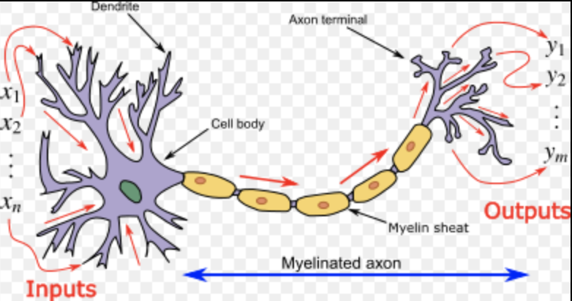
What is a Neuron?
They are the building blocks of neural network
The dendrite acts as a receivers
The axon acts a transmitters
Input to Neuron
Output from Neuron

Slide 7
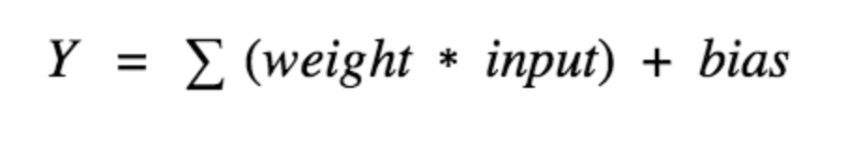
What is an Activation Function ?
Activation functions are used to check the Y value produced by a neuron and decide whether the outside connections should consider this neuron fired or not in other words activated or not.
Activation functions are also used to introduce non linearity to the network
Some Predominant activation functions: Threshold function, Sigmoid function, Rectifier function (ReLu), Hyperbolic Tangent function

Slide 8
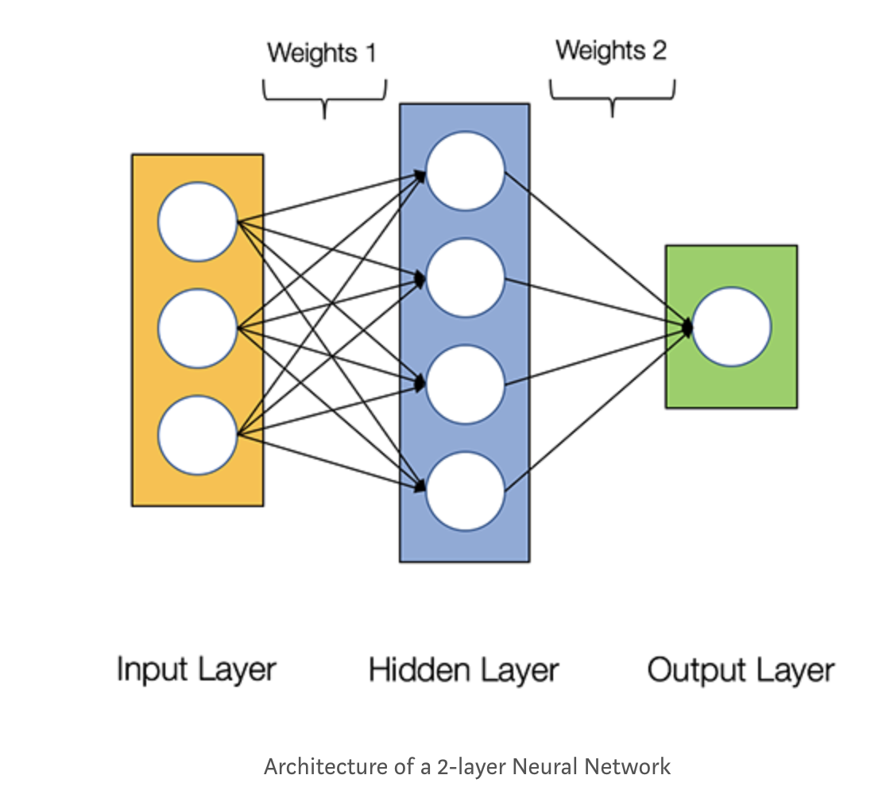
How do Neural Networks work?
Each neuron accounts for a specific property
If all the properties that a neuron is looking for are met then it fires up
A neural network may contain many hidden layers and in turn many neurons

Slide 9
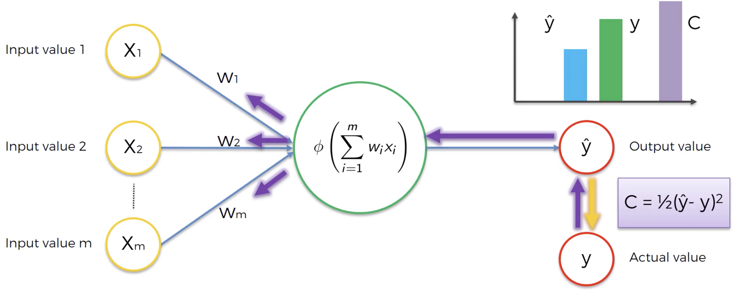
How do Neural Networks learn?
Each neuron calculates weighted sum of its input
Compares this output value to that of the actual value while training
Adjusts weights to reduce the error between the actual value and output value
This process of adjusting weights based on the cost function is called back propagation

Slide 10
Gradient Descent
Back propagation is very crucial as weights are adjusted accordingly.
Types of Gradient Descent: Batch Gradient Descent and Stochastic gradient descent
Batch gradient descent calculates the cost function error for full input set and then adjusts weights accordingly
Stochastic gradient descent is where we take each row look at cost function and then adjust weights accordingly for all rows.

Slide 11
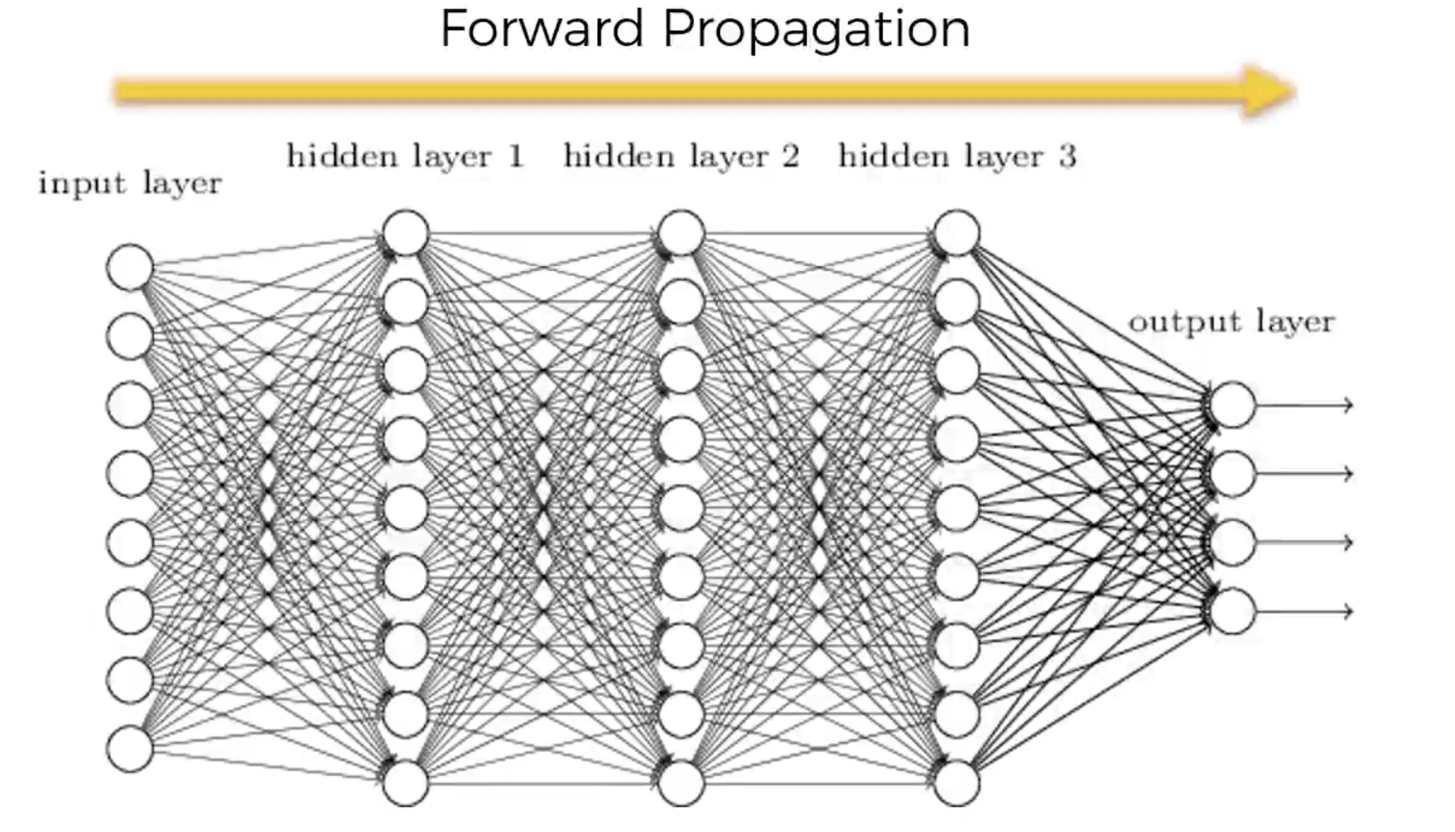
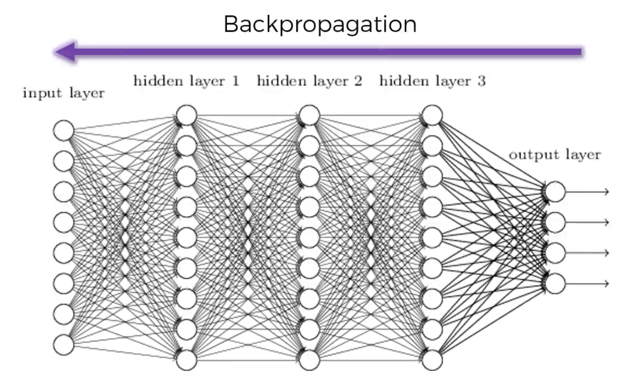
Forward and Backward propagations

Slide 12
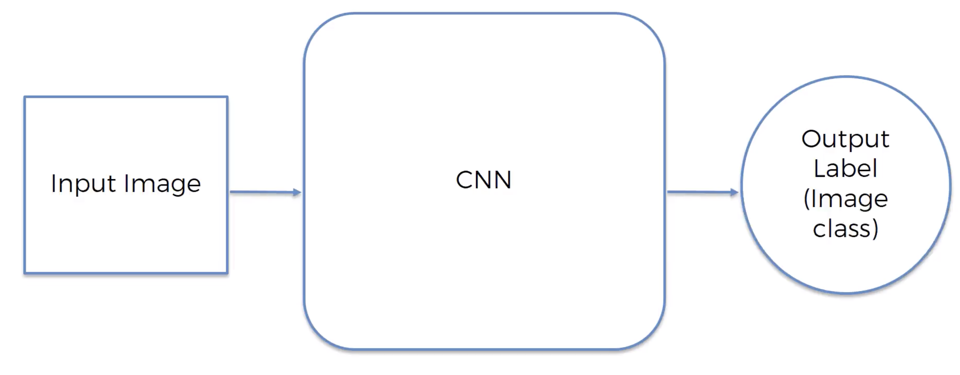
In our case

Slide 13
Convolutional Neural Network
The steps that are followed in this process would be:
Step 1: Convolution
Step 2: Max Pooling
Step 3: Flattening
Step 4: Full connection

Slide 14
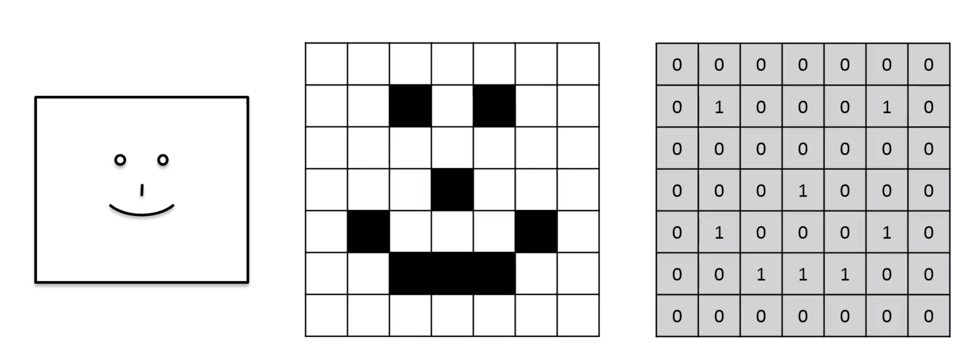
Input Image

Slide 15
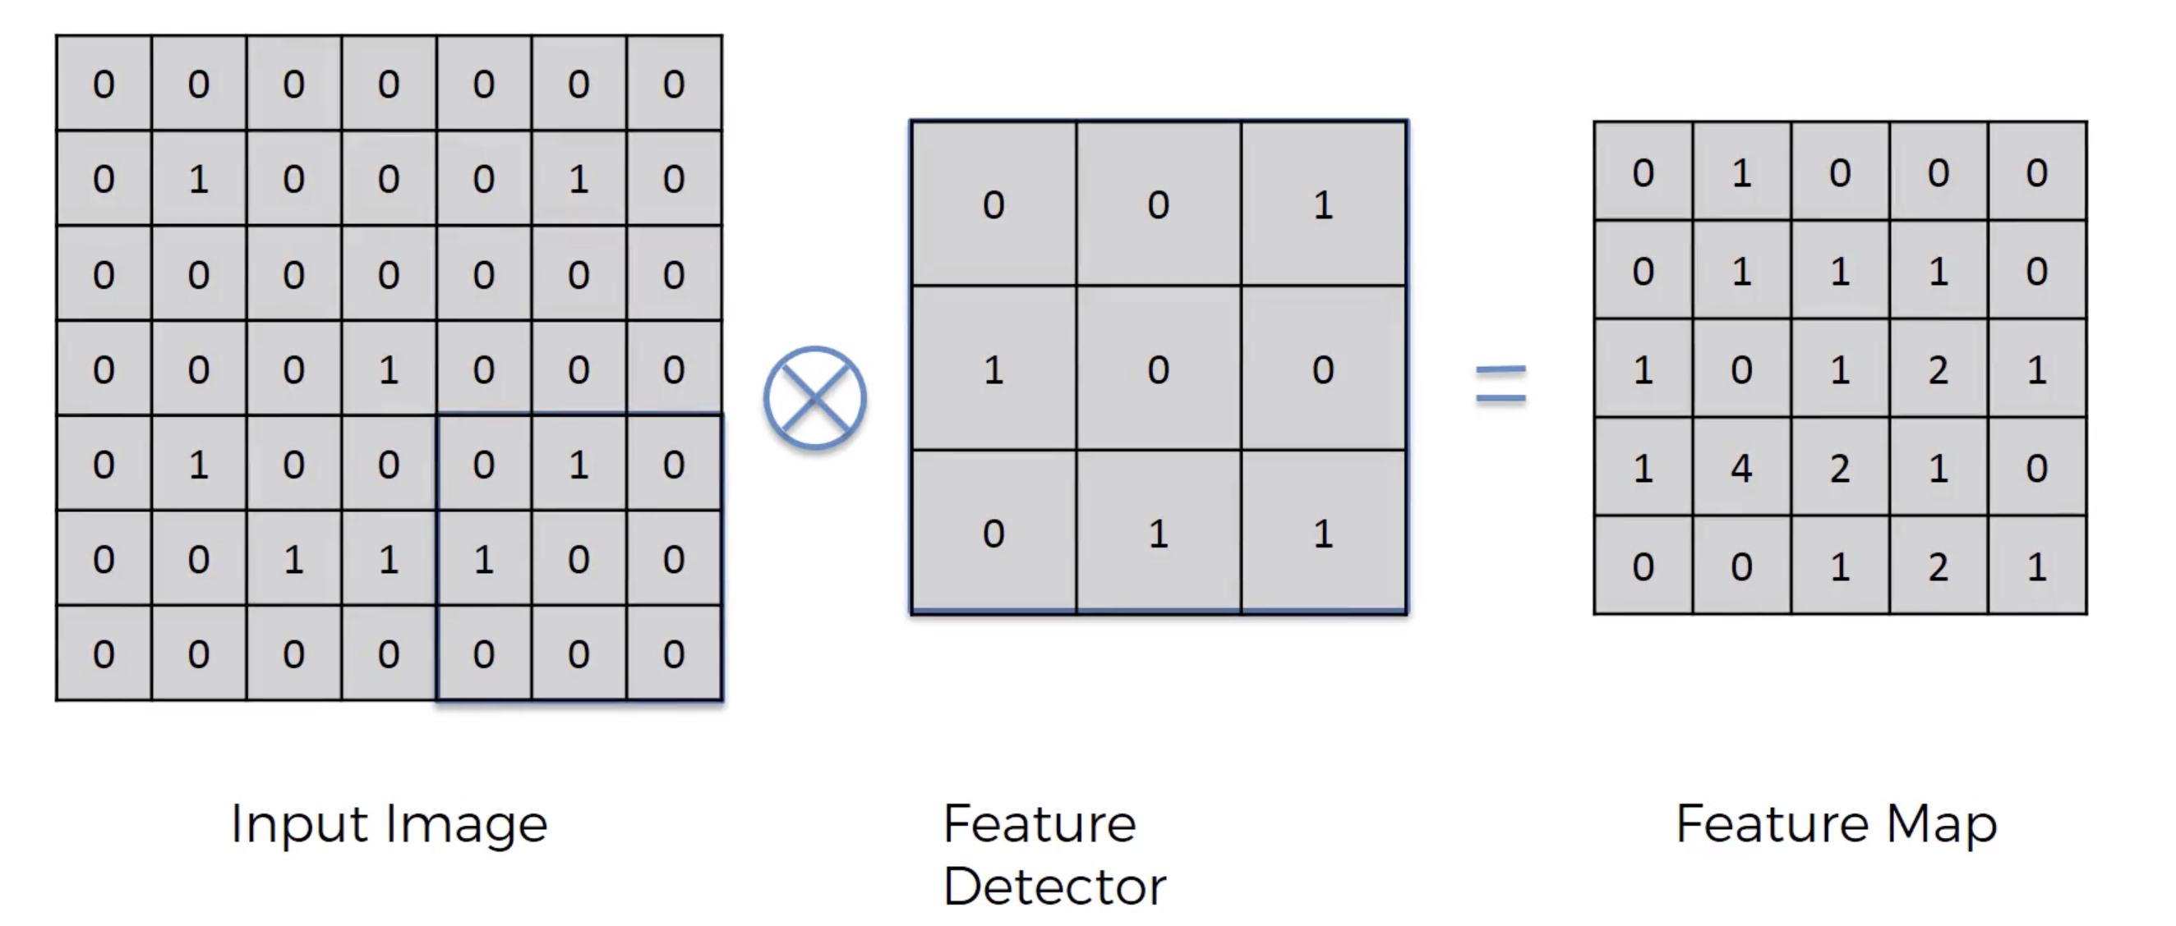
Step 1: Convolution
Input Image convolved with Feature detector at a stride of 1 which produces a Feature Map
This step is performed to reduce the size of the input image and retain back only the important features of the image
There are many such feature detectors and in turn many feature maps that are produced which form the convolutional layer
Apply Rectifier function (ReLu) to this layer to make it non-linear

Slide 16
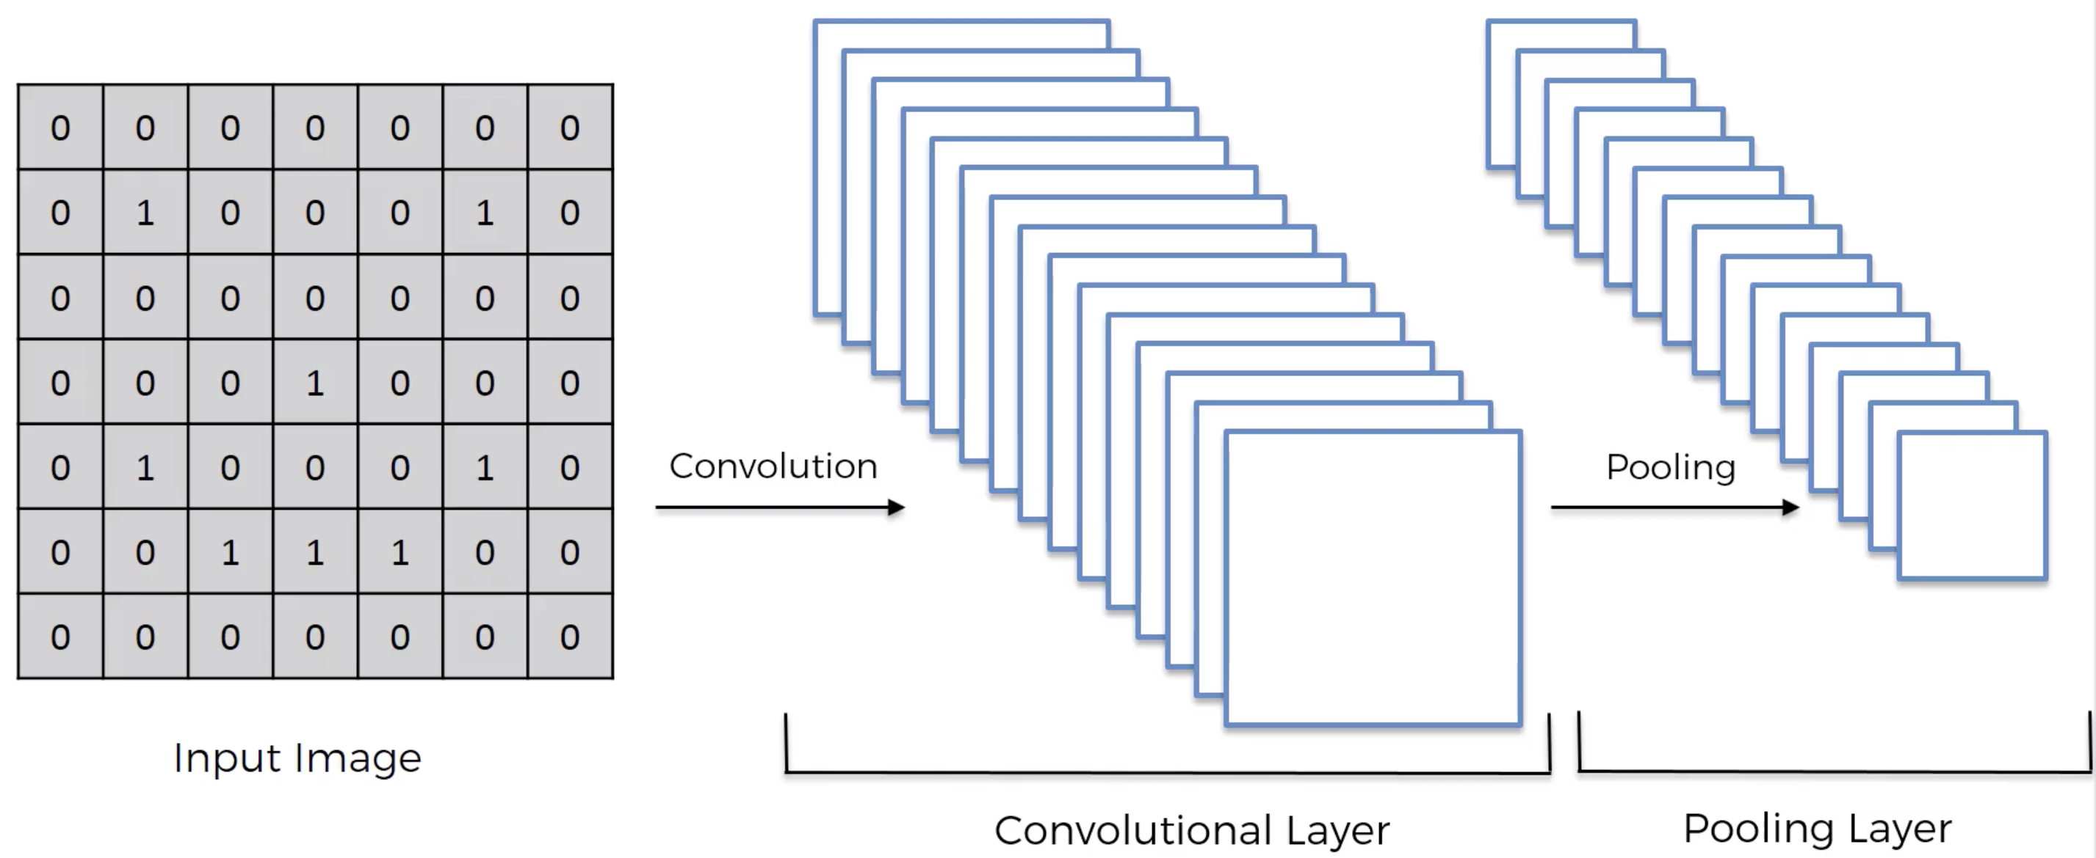
Step 2: Max Pooling
Apply max pooling to feature map which gives pooled feature map
To recognize various images of same features that differ and categorize them into one category we use max pooling
Recognizes distorted features, reduces the size as removes information thereby also prevents overfitting.

Slide 17
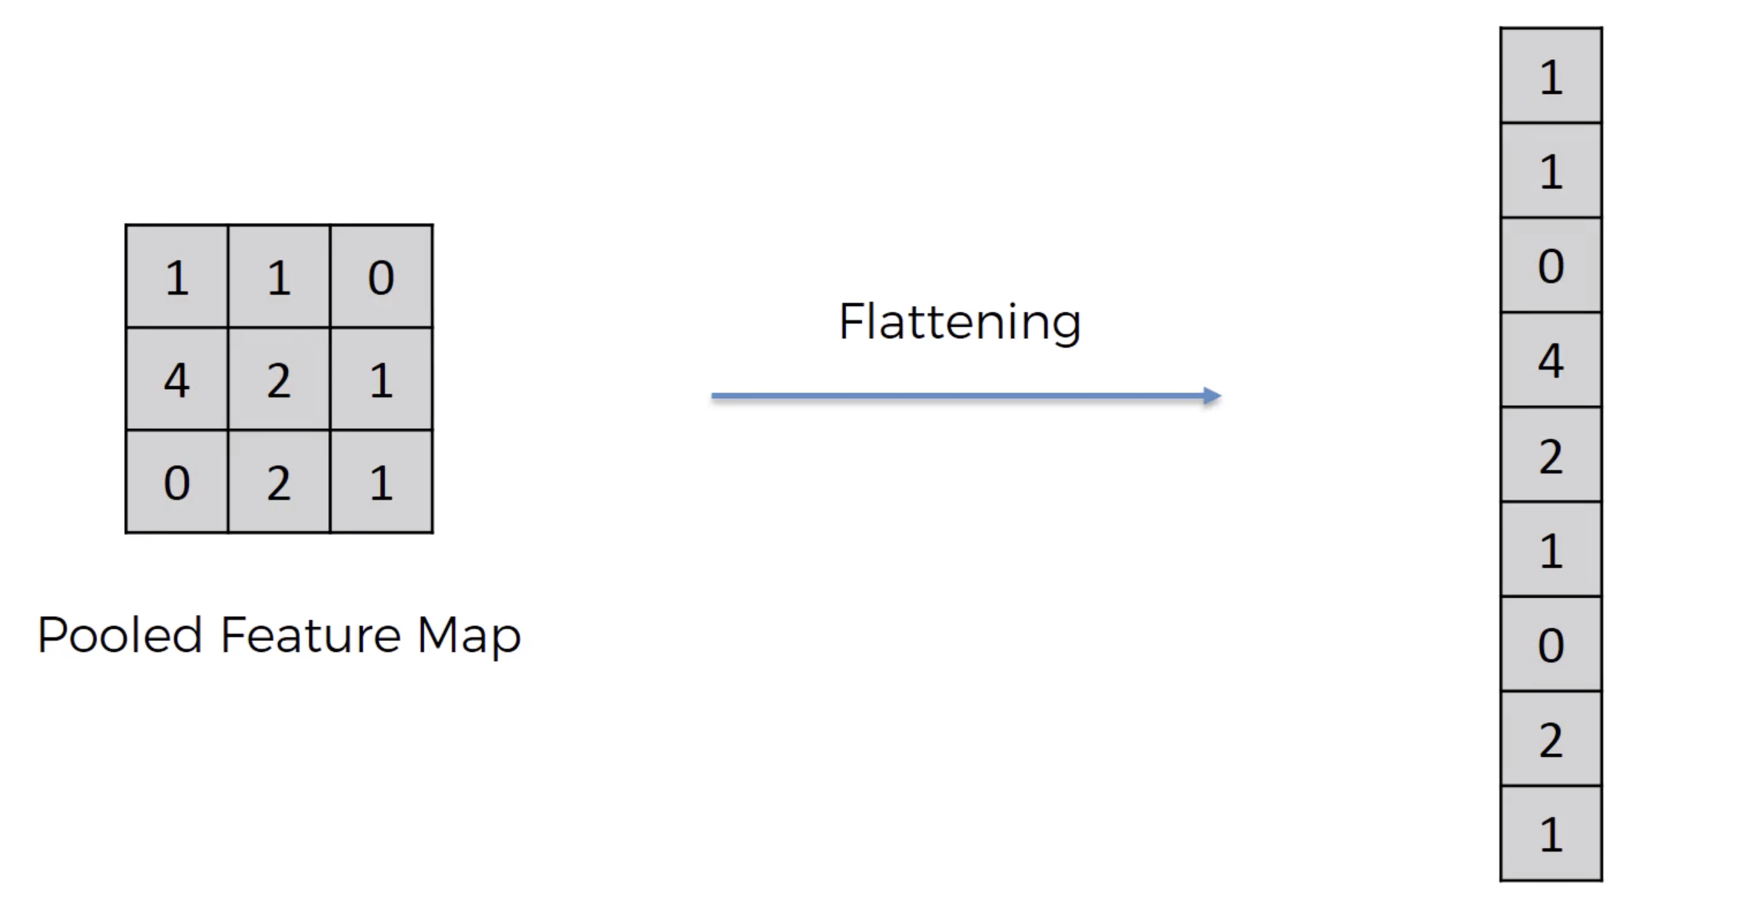
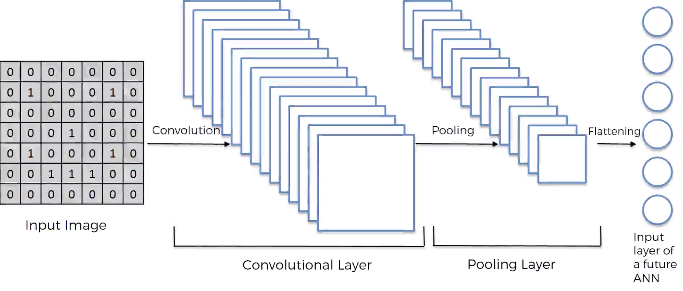
Step 3: Flattening
To input these elements into the Neural Network flattening operation is performed

Slide 18
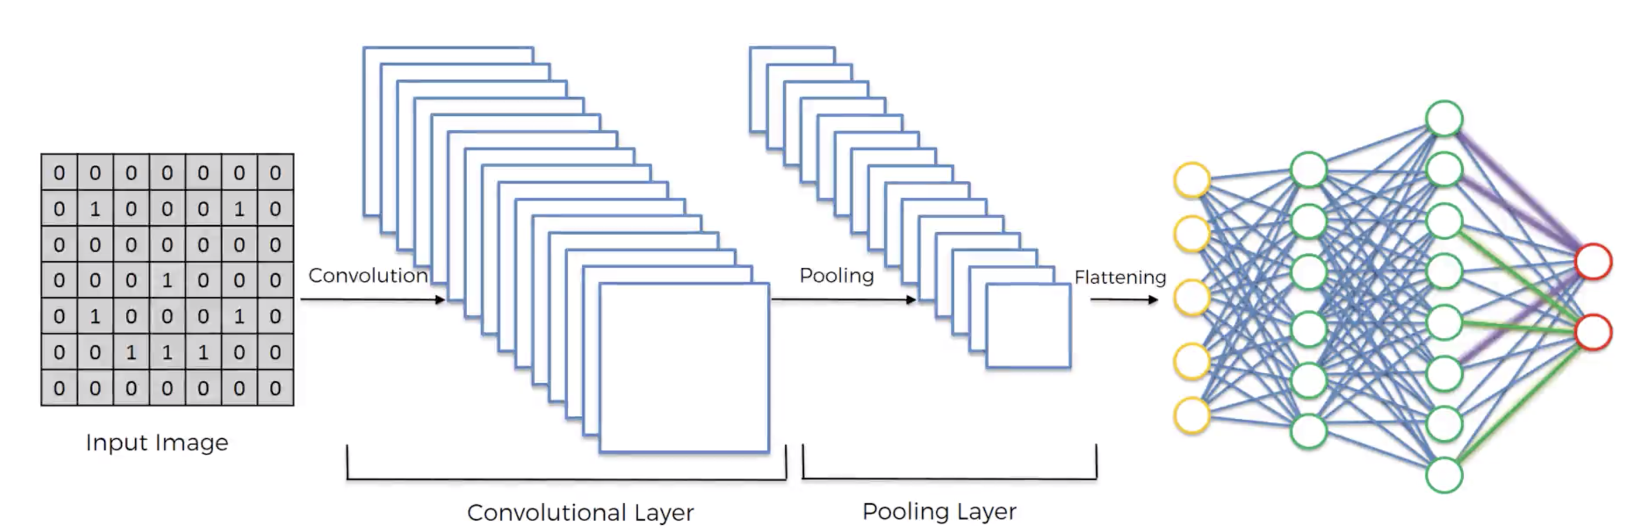
Step 4: Full connection
Features are processed and final layer performs voting towards the classes
All of this trained to a forward propagation and backward propagation with lots of iterations and Epochs
Not just weights even feature detectors are trained and adjusted and finally this network would recognize the image and categorize it

Slide 19
Code Demo

Slide 20
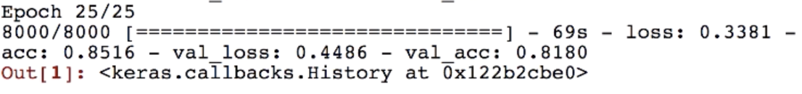
Results
Processes fast with computers that have GPU
Increase the number of Epochs for better accuracy
Training set accuracy is 85%
Accuracy attained for our model after 25 Epochs is 81.80%
Model Output

Slide 21
Thank You

